Slide 1
Security Threats of Big Data
And the GPG(Garza Pirogova Gozdzialski) Method
By
Gerardo Garza Ekaterina Pirogova Scott Gozdzialski
https://github.com/sgozdzialski/7349-Project

Slide 2
What is Big Data?
Variety – Data that is not of one type, Structured and unstructured
Volume – Data of a large volume. This continually changes. IN the e 80 a TB was big data. Now unless you are in the PBs it is manageable.
Velocity – The speed the data is produced. “Every Two Days we Create as much DATA as we did from the dawn of humanity to 2003” – Eric Schmidt, Google
Variability – The rate the Data is Produced is not Consistant
Complexity – From different sources and Different Structures

Slide 3
Why Big Data is a Security ISSues
Big Data is historically data so large it is just beyond the capabilities of current technologies.
Storage
Manage
Process

Slide 4
Big data Systems
SQL
MongoDB
Hadoop
Cassandra

Slide 5
The GPG method
Three Pronged Approach
- data at rest
- Data transmission
- Data Processing

Slide 6


GPG – First Step
Current Security Idealogy
Security is a locked box
Our Method
Security is a house

Slide 7
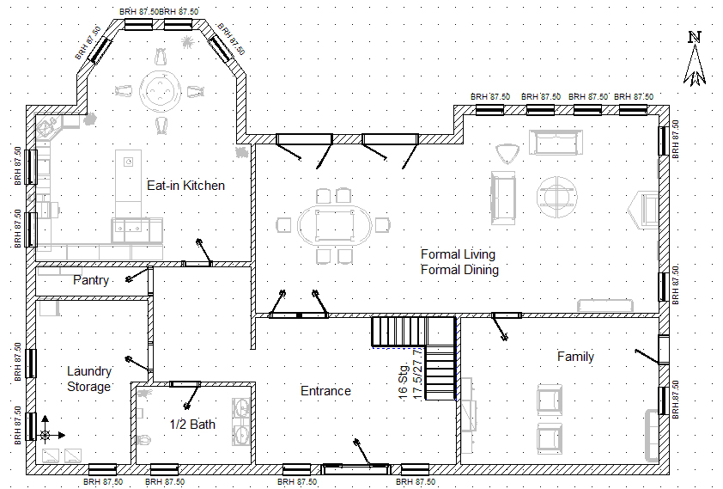
GPG – First Step Continued
Some place do not need to be secured
Some need only to be secure sometimes
Others need to be secure all the time

Slide 8
GPG – Sets within Data set
Set A
Entire Data Set
Set B
- SubSet of A in which if Set B is Secure Set A is Secure
Set CDEFtoN
- Set of B where with only a part of the Sets CDEFtoN where with only part of each set you cannot determine the content or context of set B and where the entire of any Set CDEFtoN you can not Determine the content or context of Set B. Therefore Set A is secure.

Slide 9
GPG – Sets within Data set
Set A
Entire Data Set
Set B
- SubSet of A in which if Set B is Secure Set A is Secure
Set CDEFtoN
- Set of B where with only a part of the Sets CDEFtoN where with only part of each set you cannot determine the content or context of set B and where the entire of any Set CDEFtoN you can not Determine the content or context of Set B. Therefore Set A is secure.

Slide 10
GPG – DiRe
Data Set Dissection/Resection Device
Seperates the dataset into subsets based upon rules set up by the user.
Heart of the GPG method
Works like a multiplexer, but instead of creating a congruent stream for an aggregate it creates secure un-congruent streams from the aggregate. Finally it rebuilds the pieces back into a superset.
Process Subsystem
DiRe
Storage System
Set A-B
Set B
Set CDEFtoN

Slide 11
GPG – DiRe/Data at rest
Aggregate/Set A
Storage
Determination Device
Seperater
Set A - B
Set C
Set D
Set E
Set F
Set N
Encryptor
Encryptor
Encryptor
Encryptor
Encryptor
Combiner

Slide 12
GPG – DiRe/Transmision
DiRe
Isolated Storage Location Subsystem
Storage Location 1
Storage Location 2
Storage Location 3
Storage Location N

Slide 13
GPG – Process Control
Application White listing
Servers
DiRe
SANS
Storage Subsystems/Database

Slide 14
https://github.com/sgozdzialski/7349-Project

